Slide 1
Project Quiet Place
10/14/2019
Team The 5 Quieteers
Abdullah Al-Omari (Scrum Master)
John Leckrone
Akihiro Mizusawa
Jiying Qi (Product Owner)
Vincent Thai

Slide 2
Project Quiet Place
A way to notify people when they are being too loud
Monitor sound levels and notify when they are too loud
Ability to create groups for users to anonymously notify each other
Shared volume threshold for a group of users
Dynamic volume threshold with respect to time
Create and measure a user statistics page (# of times exceeded threshold, lowest and highest levels)
Allow users to view other users’ statistics
Reward achievements and awards based off user statistics

Slide 3
Sprint 1
As a user, I want to see how loud I am so that I can put the decibel values into perspective. [Monitoring sound levels and sending notifications]
As a user, I want to be notified when I am being too loud so that I don’t disturb anyone. [Monitoring sound levels and sending notifications]
Spikes: Familiarize with React Native, JavaScript, mobile API’s
Infrastructure: Create a mobile application that listens using the microphone and sends notifications

Slide 4
Sprint 2
As a user, I want to be able to set my volume threshold so that I can be quieter in certain cases. [Change volume threshold]
As a user, I want to be able to preset daily schedules for the volume level thresholds so that I don’t have to set them before every activity. [Set dynamic volume threshold for time of day]
Spikes: Explore API to see time and determine time of day
Infrastructure: Create a settings page where you can modify volume levels for time of the day

Slide 5
Sprint 3
As a user, I want to be able to let my housemate know anonymously that they are being too loud so that I don’t have to confront them about it. [Ability to create groups for users to anonymously notify each other]
As a user, I want to be able to set a volume threshold for everyone in the group so that the house volume level is synchronized. [Shared volume threshold for a group of users]
Spike: Determine how to make a group of users, figure out database for groups and shared volume levels
Infrastructure: Setup a database that the app accesses to determine groups and shared volume levels

Slide 6
Sprint 4
As a user, I want to view my stats to know if I’m being a good roommate and improve. [Create and measure a user stats page]
As a user, I want to see how loud my housemates have been so that I know if they are improving or not. [Allow users to view other users stats]
As a user, I want to be rewarded for not being loud so I can feel good. [Reward achievements and awards based off user statistics]
Spikes: None (hopefully)
Infrastructure: Create database tables for each users stats and achievements, Reward achievements for goals reached

Slide 7
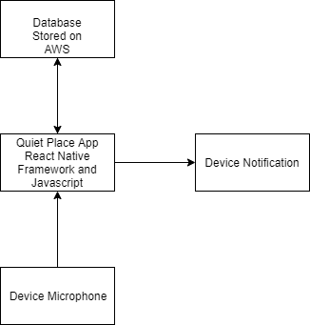
Architecture

Slide 8
Challenges/Risk
Unfamiliar with JavaScript
Unfamiliar with React Native
Unfamiliar with relational databases
Unfamiliar with SCRUM
Unfamiliar with CSS
Unfamiliar with AWS
Unfamiliar with creating a mobile application
Unfamiliar with coding

Slide 9
Technologies
Languages: JavaScript, HTML, CSS
Framework: NoSQL databases, React Native
Services: Github, VSCode, AWS DynamoDB

Slide 10
Minimum Viable Product
Create a mobile application that monitors the decibel levels through the microphone, sets specific volume thresholds, and notifies the user whenever they exceed those thresholds.
As a user, I want to see how loud I am so that I can put the decibel values into perspective.
As a user, I want to be notified when I am being too loud so that I don’t disturb anyone.
As a user, I want to be able to set my volume threshold so that I can be quieter in certain cases.

